Slide 1
Jquery
SE 3355 Web Development
Lect. Barış Ceyhan

Slide 2
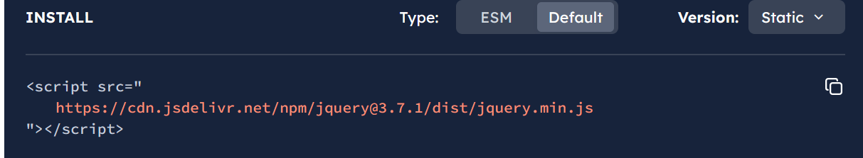
Motivation
Javascript for all browsers, cross-browser
Library with useful syntax. Not a framework (React.js, view.js)
Less code
CSS3 compliant
Download or use via CDN

Slide 3
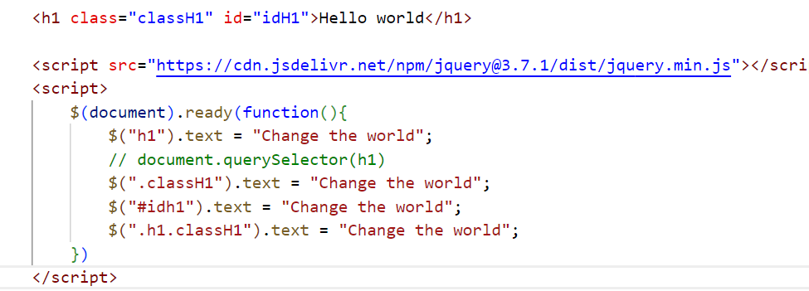

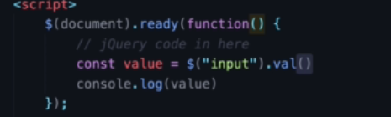
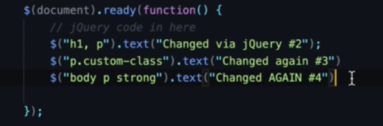
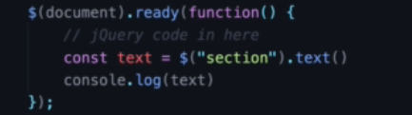
Syntax-selector
Works pretty much like CSS
.text vs .html
.val()

Slide 4
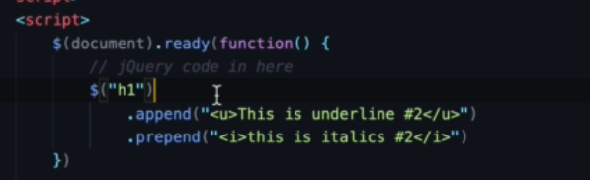
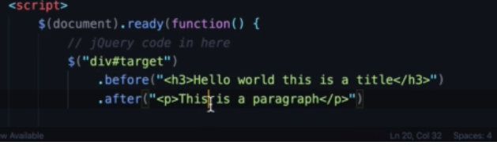
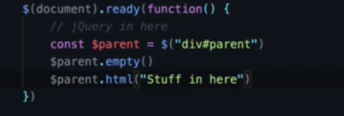
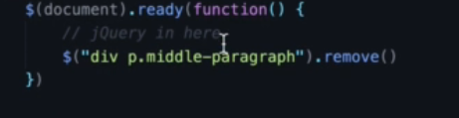
Append/prepend before/after elements
append/prepend
Chaining
before/after
.remove element(s)
Delete all childe elements .empty()

Slide 5
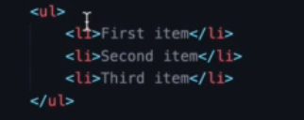

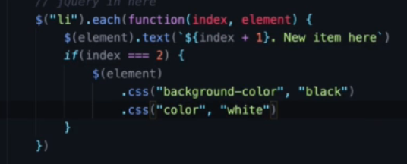
Loop through elements
Using .first, :last , .each

Slide 6
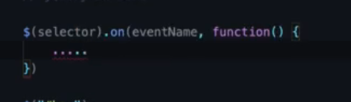
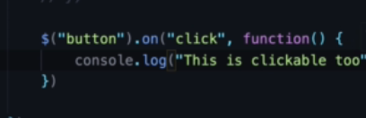
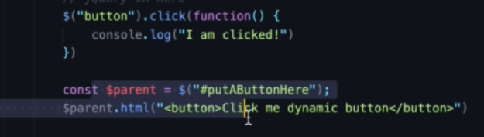

Event listeners - click
Add logic to events
click()
Which of below will work i.e dynamic

Slide 7
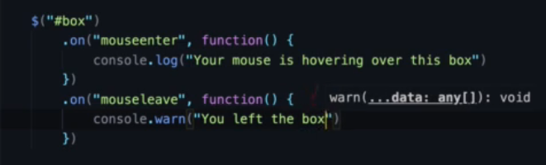

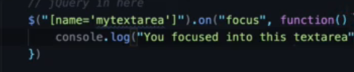
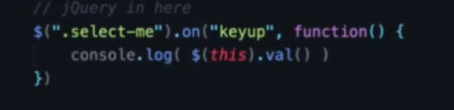
Event listeners – hover. keyup, focus
mouseenter, mouseleave
hover used in CSS
keyup
$(this)
focus – gain focus

Slide 8

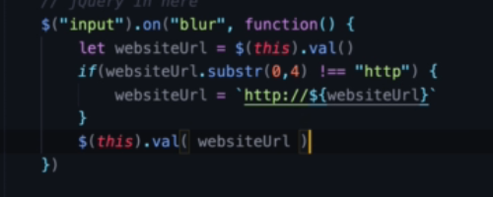
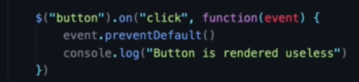
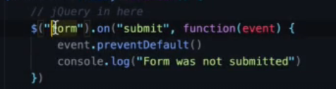
Event listeners – blur, form submission
Blur – lost focus
Form event listeners
preventDefault()

Slide 9




Hide show elements
hide(), show()
display:none, block;
Quite popular
Toggle() – hide show

Slide 10
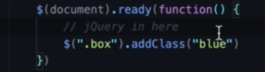
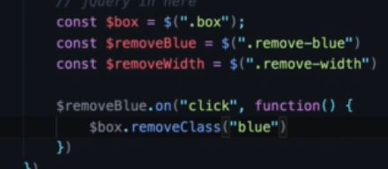
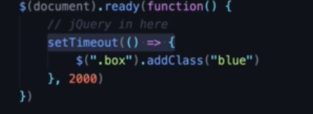
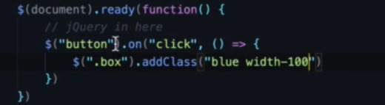
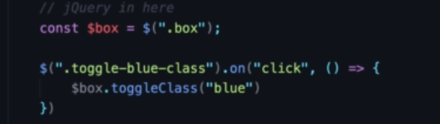
Add, remove CSS classes
addClass, removeClass
toggleClass – add/remove at the same time

Slide 11
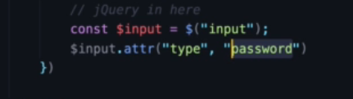
Change attribute
Attr
Can change/retrieve any attribute of an element

Slide 12
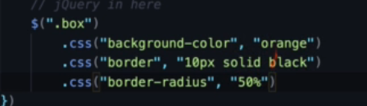
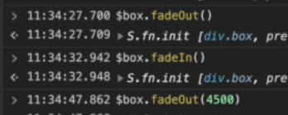
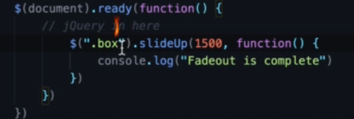
Adding custom css, callback functions
.css
fadeIn, fadeout
slideUp/down – smooth show hide
Use with callback functions

Slide 13
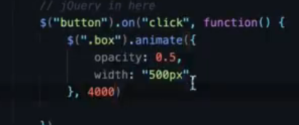
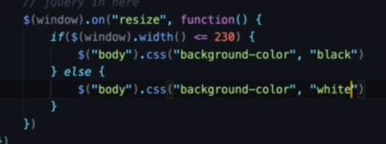
Animate, resize
Can animate anything with numbers
Width, font-size
colors?
resize. Try with window selector $(window)

Slide 14
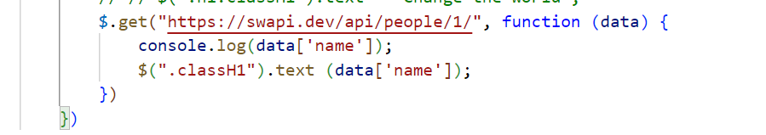
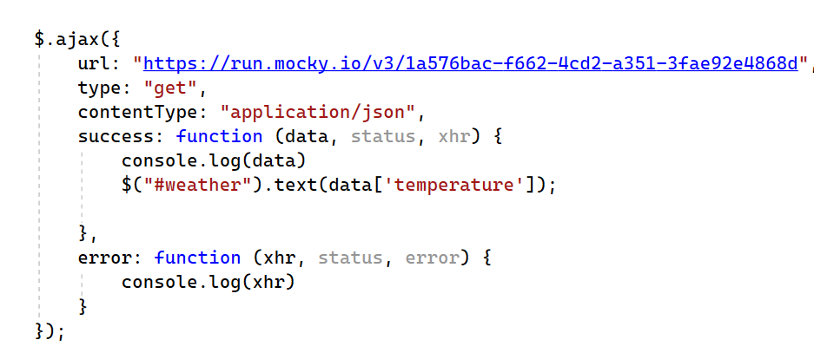
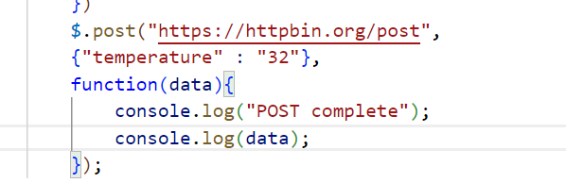
AJAX get post
.get, .post
.ajax
Mocky.io – create mock APIs

Slide 15
Resources
https://www.w3schools.com/jquery/default.asp

